Slide 1
Students with Disabilities and their inclusion in Universities

Slide 2
My topic inclusion in the classroom at the university level and Disabled student’s occupations
Occupational Therapy: a form of therapy for those recuperating from physical or mental illness that encourages rehabilitation through the performance of activities required in daily life.
Occupations: Activities of Daily living that include but are not limited to self care, leisure, work, hygiene, and/or school
Disabilities: a physical or mental condition that limits a person's movements, senses, or activities.
Inclusion: all students are fully accepted members of their school community
My Argument: Inclusive efforts at the university level need to go farther
https://www.youtube.com/watch?v=ZIPsPRaZP6M

Slide 3
Why this topic?
IDEA was not enacted until 1975 while ADA was not enacted until 1990
This is a relatively ‘new’ problem that is finally being addressed

Slide 4
My Project
Wiki website to explain…
Occupational therapy
The occupations of students with disabilities vs without
Inclusion in the classroom
Real life examples of students
How to make a change for the better
My goal is to share information to not only OT students but all students and their universities

Slide 5
Sources & where I plan to go
The Exceptional Child: Inclusion in Early Childhood Education- Journal Article
“normal” and “exceptional” development.
Inclusion of Students with Autism Spectrum Disorders.- Teacher Article
Teacher Perspective
The Power of Inclusive Education – TedTalk
professor in the Area of Special Education at the University of Washington, talks of the importance of inclusion and how the lessons it teaches can be carried outside of the classroom.

Slide 6
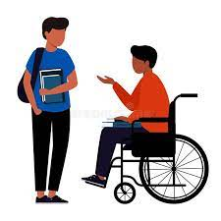
Interviews
I plan to interview students with and without disbailities to see their perspective of being in the classroom and of one another
I also aim to interview professors and/or the leader of disability services/inclusion at Duquesne

Slide 7
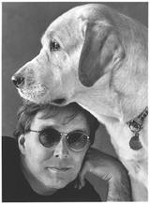
Planet of the blind
Detail of what its like to have a disability in comparison to non-disabled people around you
Use quotes and excerpts specifically from what Kuusisto experienced

Slide 8
Relevance to Global DIVERSITY
People with disabilities in the classroom need to be included and represented not only in the classroom but everywhere
This relates to other minority groups we’ve discussed in class and how they’ve felt including
Loneliness
Isolation
Depression
Self hatred

